Slide 1
Dependency Injection and attribute selector
Hardeep kaur Dhalla

Slide 2
Objectives
DI – Dependency Injection
Create an attribute selector

Slide 3
Dependency injection in Angular
Dependencies are services or objects that a class needs to perform its function.
Angular's DI framework provides dependencies to a class upon instantiation.
To generate a new HeroService class in the src/app/heroes folder use the following Angular CLI command.
ng generate service heroes/hero

Slide 4
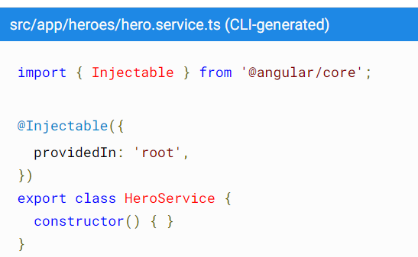
@Injectable()
The @Injectable() decorator specifies that Angular can use this class in the DI system.
The metadata, providedIn: 'root', means that the HeroService is visible throughout the application.

Slide 5
Best practice
For clarity and maintainability, it is recommended that you define components and services in separate files.
If you do combine a component and service in the same file, it is important to define the service first, and then the component.
If you define the component before the service, Angular returns a run-time null reference error.

Slide 6
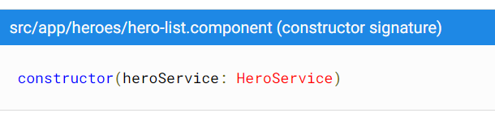
Injecting services
To a component
Using services in other services, follow the same pattern as injecting into a component.

Slide 7

Create an attribute directive
Change the appearance or behavior of DOM elements and Angular components with attribute directives.
To create a directive, use the CLI command

Slide 8
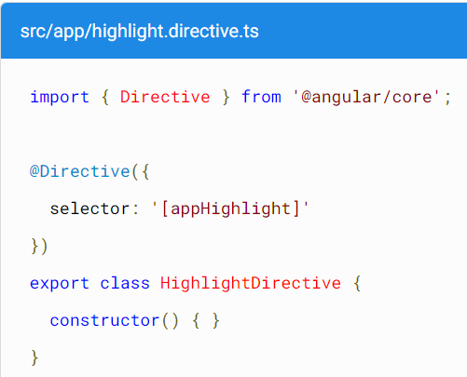
Create an attribute directive
The CLI generates the default src/app/highlight.directive.ts as follows:
Also, it will declare the directive class in the AppModule.

Slide 9
ElementRef
ElementRef - A wrapper class around a native element inside of a View.
https://angular.io/api/core/ElementRef
nativeElement – only property of this class which gives access to the underlying native host DOM element.

Slide 10
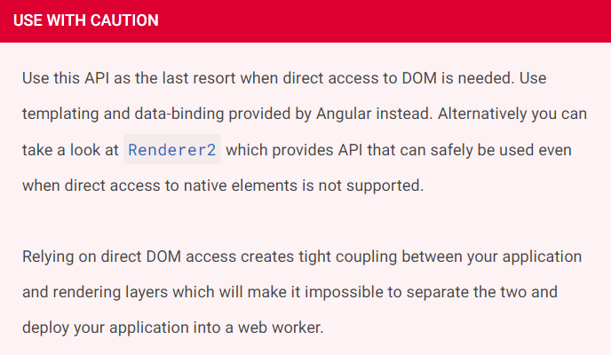
Direct DOM manipulation not a good thing…

Slide 11
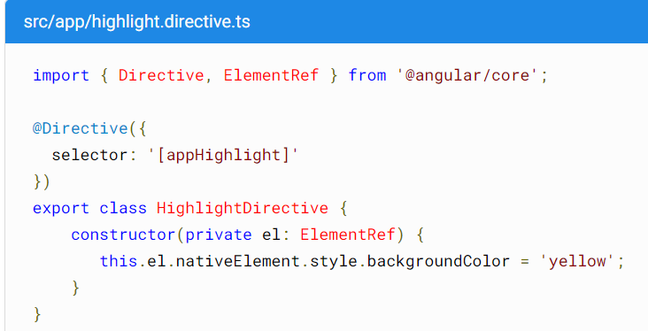
Inject ElementRef

Slide 12
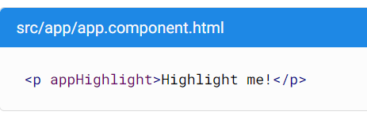
Applying an attribute directive

Slide 13
Handling user events
Using HostListener decorator - Decorator that declares a DOM event to listen for and provides a handler method to run when that event occurs.

Slide 14
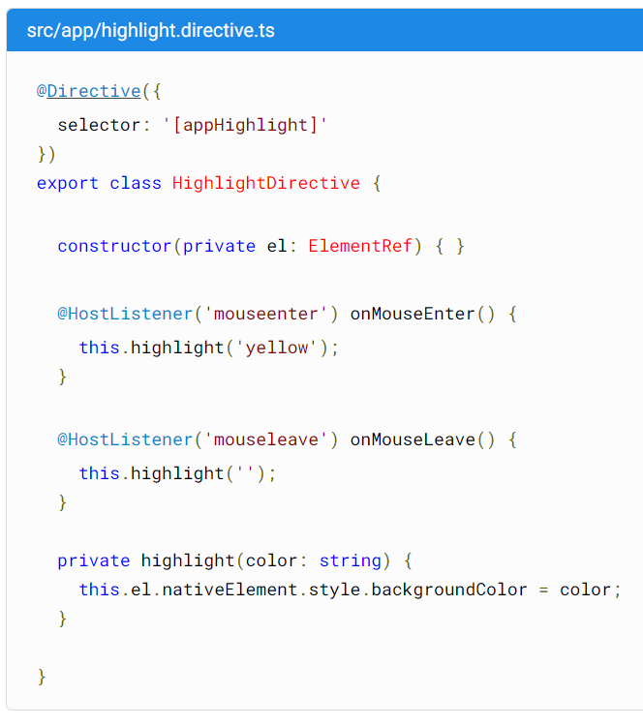

Slide 15
Renderer2 class
https://angular.io/api/core/Renderer2
By default, Angular renders a template into DOM. Meaning works in browser.
But you can also render to something other than DOM.

Slide 16
HostBinding class
Another way to change the DOM property that is bound to a data property.
https://angular.io/api/core/HostBinding#hostbinding

